Slide 1

Playback Instrument

Slide 2
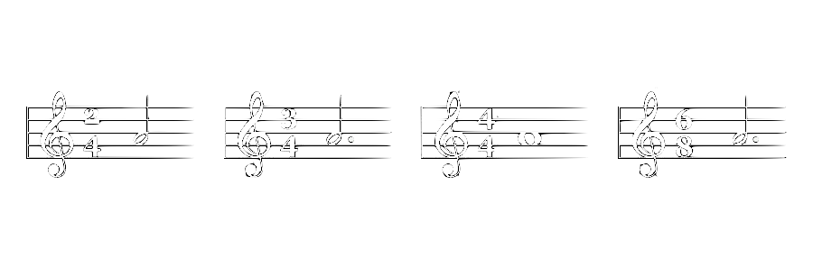
Time Signature

Slide 3

Tempo
Back

Slide 4
G8RSCRIBE
Start
Title |
Time Signature
Key Signature
Tempo
Playback Instrument

Slide 5
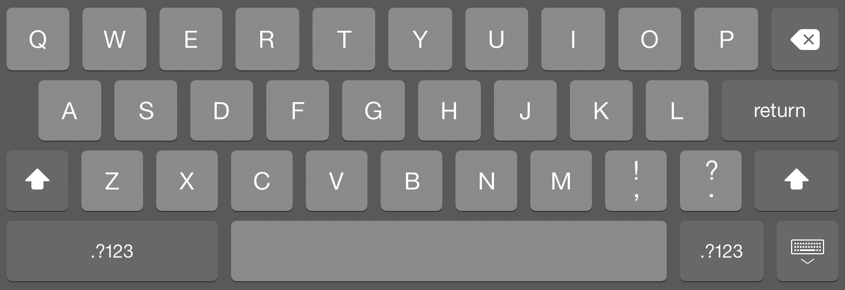
Song Title
Title |

